Slide 1
MSHA Training Summit 2nd Quarter
August 27, 2014

Slide 2
25 MNM Fatal Accidents 10/2013-08/2014

Slide 3
Fatal Accidents by Commodity
8 Sand & Gravel
3 Crushed Stone
3 Silver
3 Cement
2 Lime
1 Sand
1 Gold
1 Granite
1 Clay
1 Iron Ore
1 Gypsum

Slide 4
Fatal Accidents by Occupation
Supervisor – 8
Miner/Laborer - 8
Truck Driver – 3
Scaler – 2
Electrician – 1
Dozer Operator – 1
Mechanic – 1
Plant Operator – 1

Slide 5
Fatal Accidents by Category
7 Underground – 18 Surface
5 Contractors – 20 Mine Employees
The following accident categories were identified
5 Powered Haulage
3 Explosives
4 Falling/Sliding Material
3 Machinery
3 Fall of Person
2 Fall of Rib
2 Electrical
1 Other (Drowning)
1 Hoisting
1 Explosion of Gas

Slide 6
Powered Haulage

Slide 7
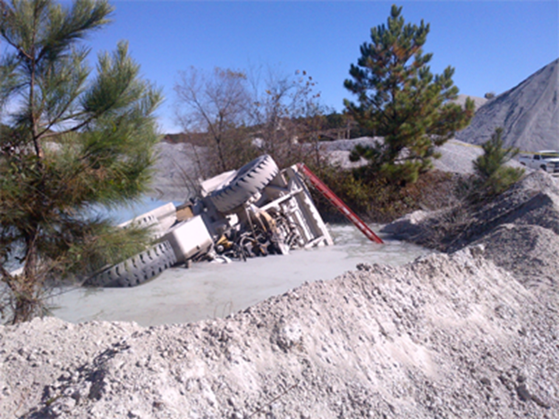
Fatality #15 - November 7, 2013 Powered Haulage – Georgia – Crushed, Broken Granite Vulcan Construction Materials, L.P. –
Lithia Springs Quarry

Slide 8
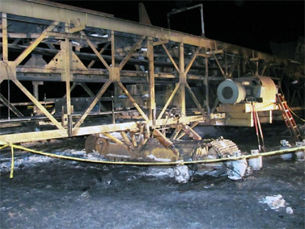
Fatality #1 - February 1, 2014 Powered Haulage – Utah - Iron Ore Gilbert Development Corporation (GDC)
Comstock / Mountain Lion

Slide 9
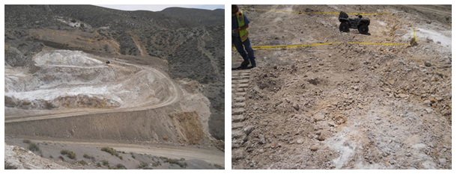
Fatality #11 - May 1, 2014 Powered Haulage - Nevada - Gypsum Silver State Minerals LLC - Gypsum Mountain

Slide 10
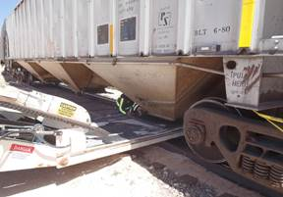
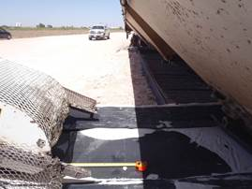
Fatality #12 - May 9, 2014 Powered Haulage - Texas - Construction Sand and Gravel Mississippi Sand, LLC - Mississippi Sand Seagraves

Slide 11
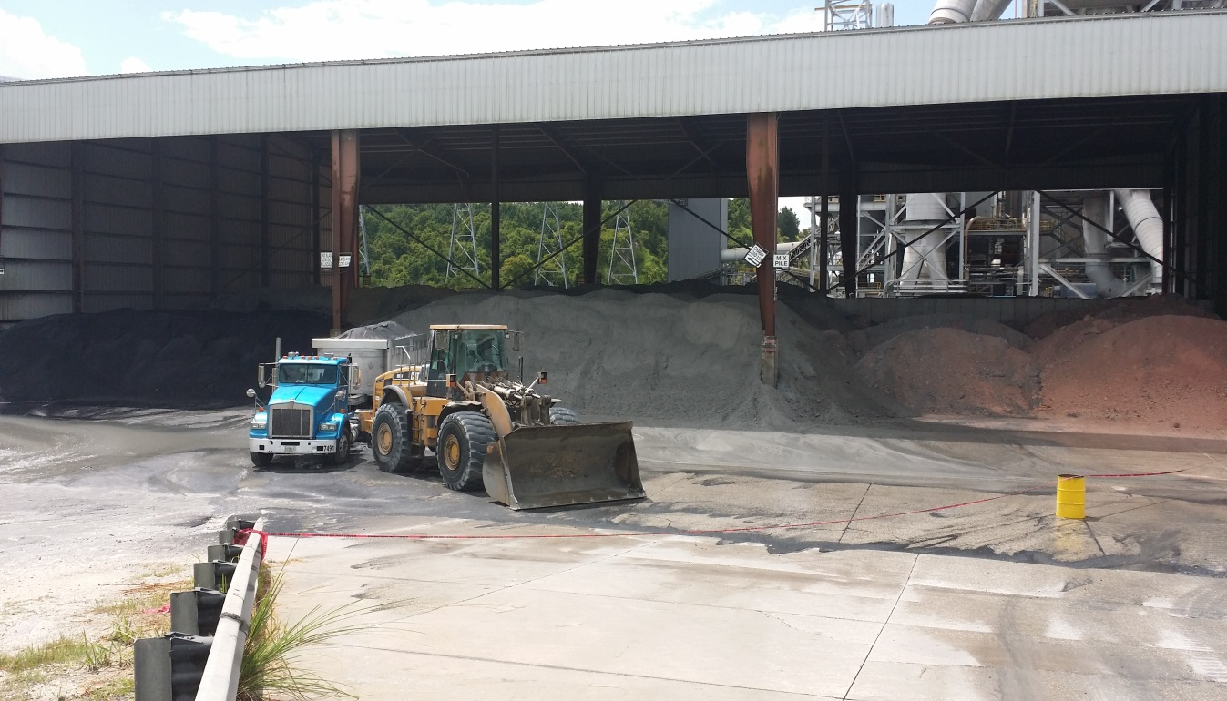
Fatality #16 - July 23, 2014 Powered Haulage - Florida - Cement Cemex Construction Materials of Florida LLC - Brooksville South Cement Plant

Slide 12
Explosives

Slide 13
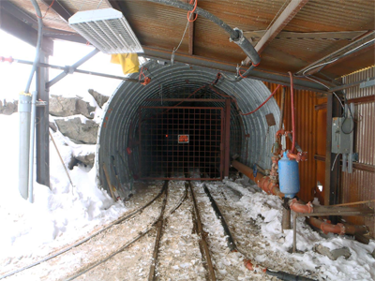
Fatality #16 & #17- November 17, 2013 Explosives/Breaking Agents – Colorado – Silver Star Mine Operations, LLC - Revenue Mine

Slide 14
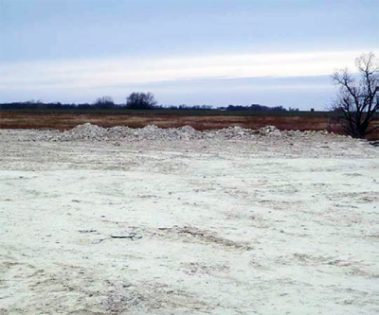
Fatality #19 - December 4, 2013 Explosives/Breaking Agents – Kansas – Crushed, Broken Limestone Bayer Construction Company, Inc. - Kansas Falls Quarry

Slide 15
Falling/Sliding Material

Slide 16
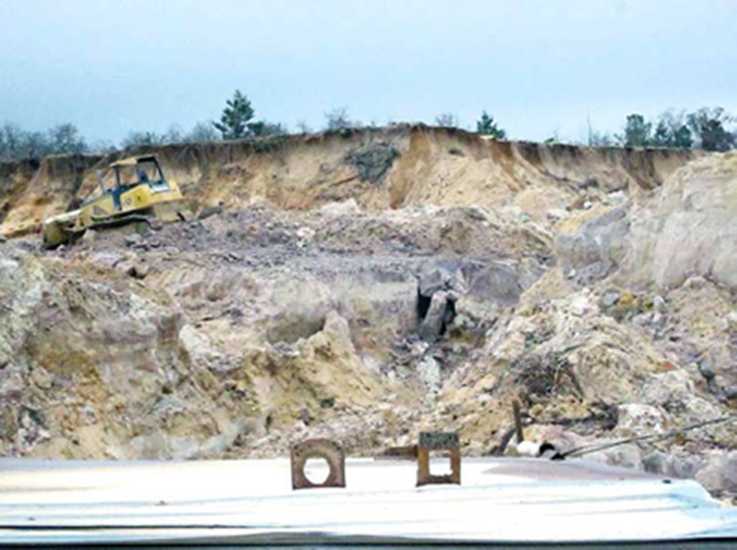
Fatality #21 - December 13, 2013 Falling/Sliding Material – Georgia - Construction Sand and Gravel Brown Brothers Sand Company - Wittichen Stephen Plants

Slide 17
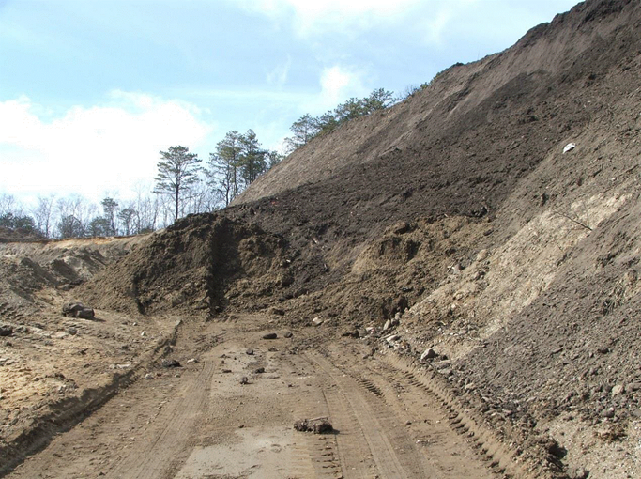
Fatality #3 - February 28, 2014 Falling/Sliding Material – New York - Construction Sand and Gravel East Coast Mines Ltd - East Coast Mines Ltd

Slide 18
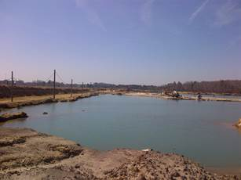
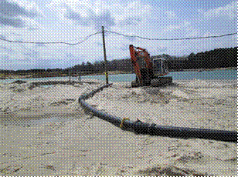
Fatality #4 - March 27, 2014 Falling/Sliding Material -Virginia - Construction Sand and Gravel Baillio Sand Company Inc. - Lord Farm #5

Slide 19
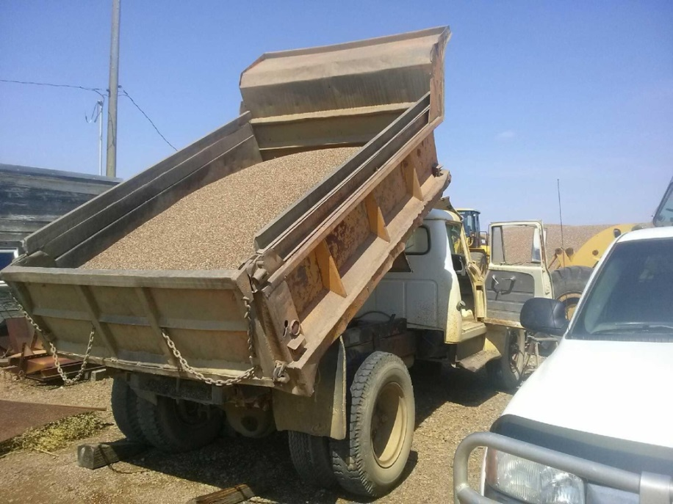
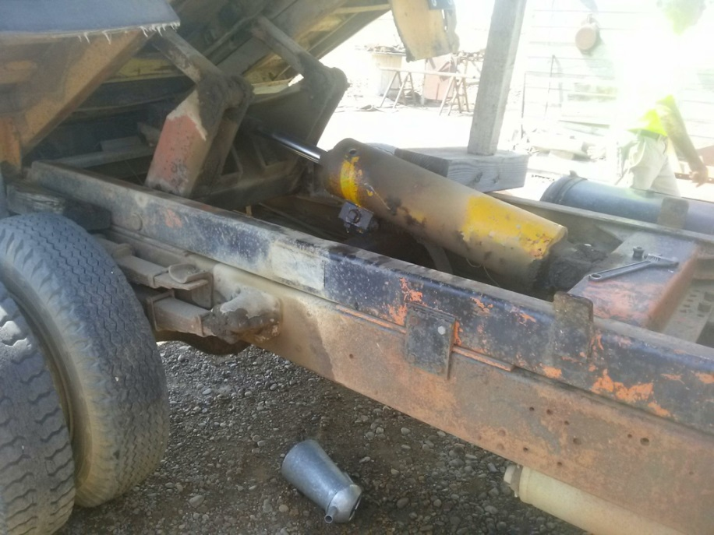
Fatality #17 - August 2, 2014 Falling Material - Montana - Construction Sand and Gravel Fossum Ready Mix - Belzer Pit

Slide 20
Machinery

Slide 21
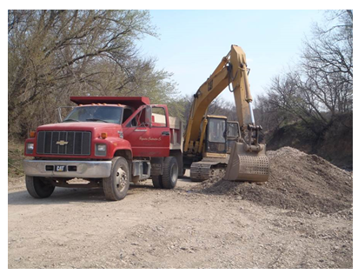
Fatality #7 -April 17, 2014 Machinery -Kansas - Construction Sand and Gravel Hafenstine Construction - Hafenstine Plant #1

Slide 22
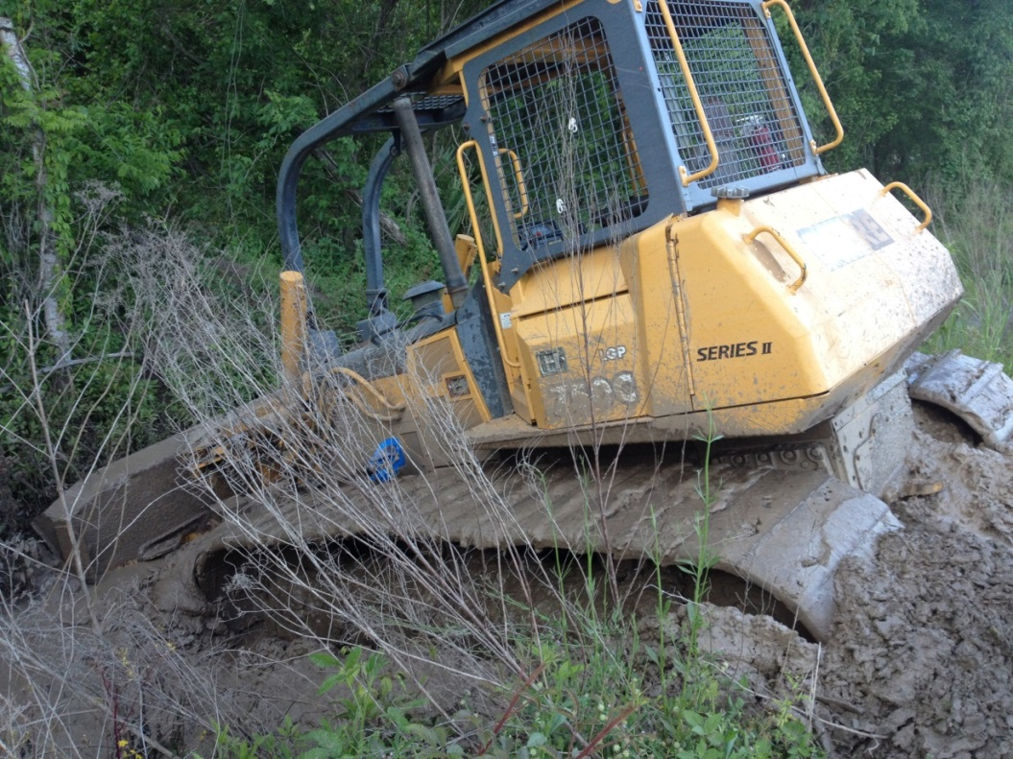
Fatality #8 - April 24, 2014 Machinery - Louisiana - Fire Clay Big River Industries - Gravelite Division

Slide 23
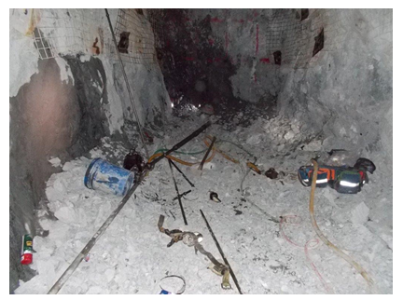
Fatality #10 - April 28, 2014 Machinery - Nevada - Gold Ore Klondex Midas Mine Inc. - Midas Mine

Slide 24
Fall of Person

Slide 25
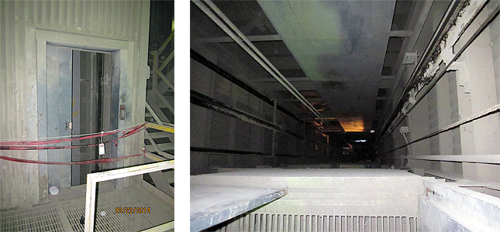
Fatality #2 - February 21, 2014 Fall of Person –Kentucky - Cement CEMEX, Inc. - Kosmos Cement Co.

Slide 26
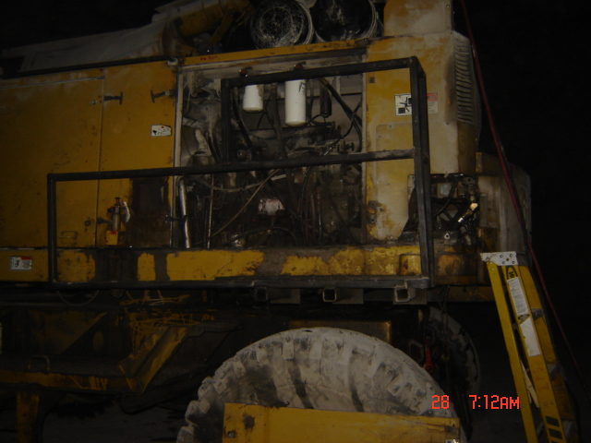
Fatality #9 - February 27, 2014 Fall of Person - Iowa - Crushed, Broken Limestone NEC Martin Marietta Materials, Inc. - Ames Mine

Slide 27
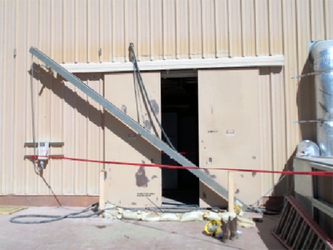
Fatality #14 - October 17, 2013 (Victim Died October 19, 2013) Slip/Fall of Person – California – Cement National Cement Company Of California Inc - Lebec Cement Plant

Slide 28
Fall of Rib

Slide 29
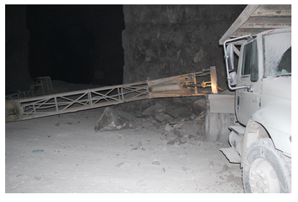
Fatality #5 & Fatality #6-April 11, 2014 Fall of Rib. -Missouri - Lime Mississippi Lime Company - Mississippi Lime Company-Ste. Genevieve

Slide 30
Electrical

Slide 31
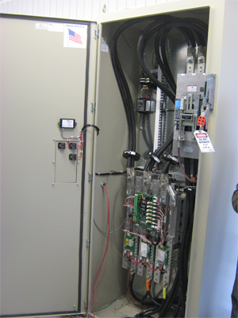
Fatality #18 - November 18, 2013 (Victim Died November 22, 2013) Electrical – Kentucky – Crushed, Broken Limestone NEC Pine Bluff Sand & Gravel Company - Cumberland River Quarry

Slide 32
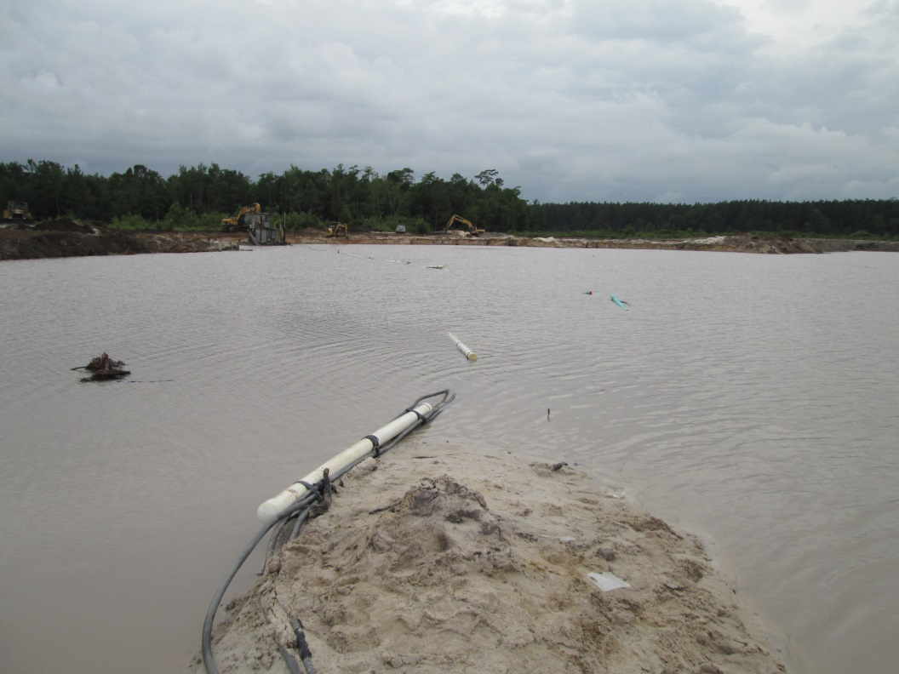
Fatality #15 - July 21, 2014 Electrical - South Carolina - Construction Sand and Gravel Murray Mines Inc. - Murray Mines Inc.

Slide 33
Other (Drowning)

Slide 34
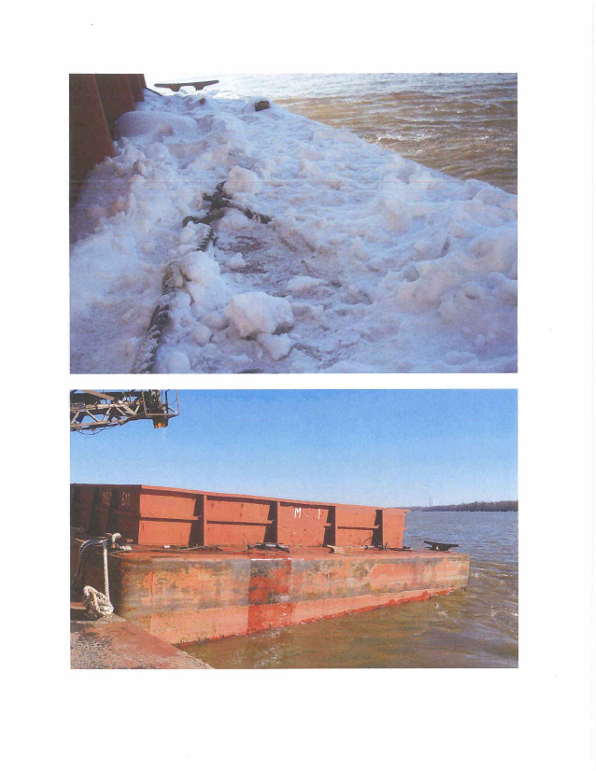
Fatality #22 - December 10, 2013 Other (Drowning) – Kentucky - Construction Sand and Gravel Hunter Sand & Gravel, LLC. - Dredge IV

Slide 35
Hoisting

Slide 36
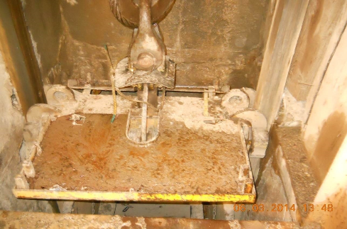
Fatality #13 – June 2, 2014 Hoisting – Idaho – Silver Silver Opportunity Partners LLC – Sunshine Mine

Slide 37
Explosion of Gas

Slide 38
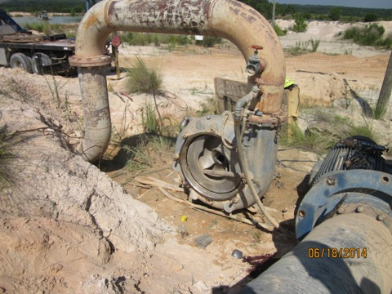
Fatality #14 - June 18, 2014 Ignition/Explosion of Gas - South Carolina - Construction Sand and Gravel Hanson Aggregates Southeast, LLC - Brewer Sand

Slide 39
Proactive Approaches to Prevent Recurrence
Provide training, including Task Training
Conduct workplace examinations
De-energize power and Lock Out/Tag Out
Conduct Pre-operational checks
Maintain Mobile equipment
Provide/wear Personal Protective Equipment

Slide 42
Additional Assistance
EFSMS Training Assistance Available to Mine Operators
Instructor workshops
Update training plan
Review training records
Part 46 or Part 48 workshop
Evaluate and monitor training
Onsite training program review and assistance
Workplace examination training
Provide supervisory responsibility training
Training materials available through EFSMS and the National Mine Academy

Slide 43
Training Materials
Catalog of training materials and products
Best practice cards
Video clips
Holmes safety bulletins
MSHA Library
Toolboxes
Interactive training materials
Training plan development
Training records
NIOSH
Holmes Safety Association
Holmes Mine Rescue Association
National Mine Academy
EFSMS contact information

Slide 44

Annual seminar (no registration fees) that provides opportunities for health and safety trainers to improve their training programs with new ideas and materials
Date: October 14-16, 2014
Location: National Mine Health and Safety Academy - Beaver, WV
Additional information and registration forms can be found on the MSHA website: http://www.msha.gov or you may contact Angela Blair at (304)256-3202 or blair.angela@dol.gov

